Slide 1
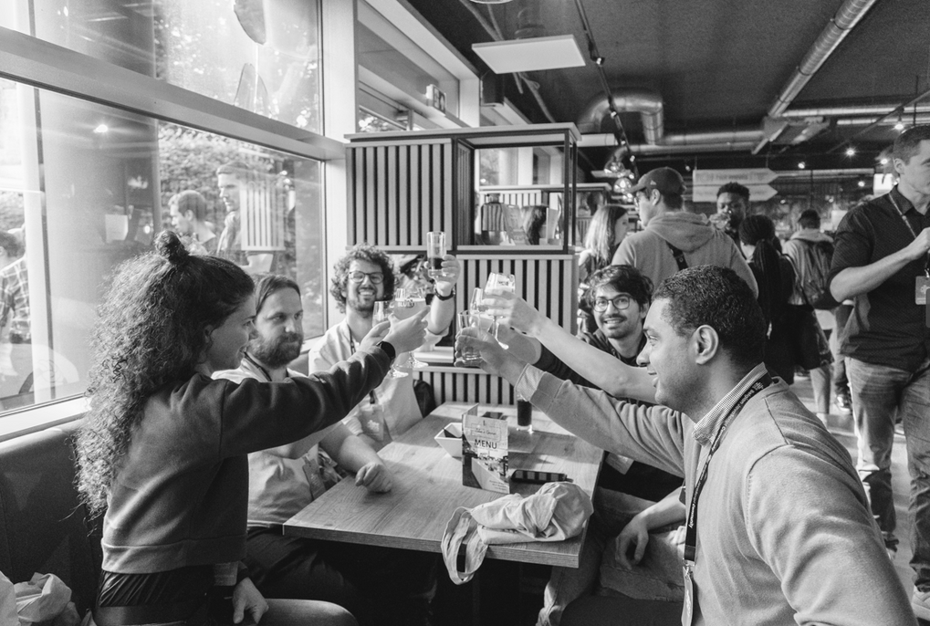
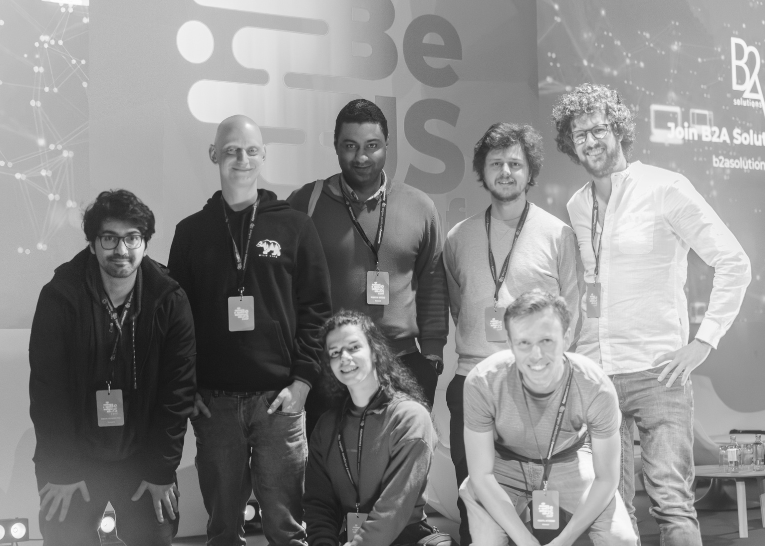
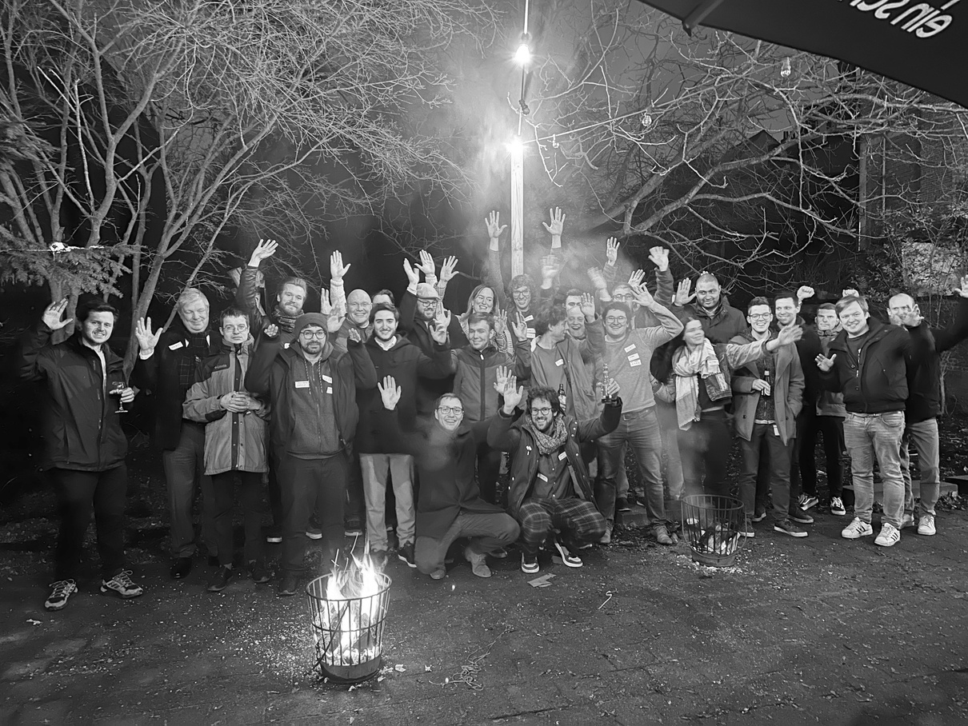


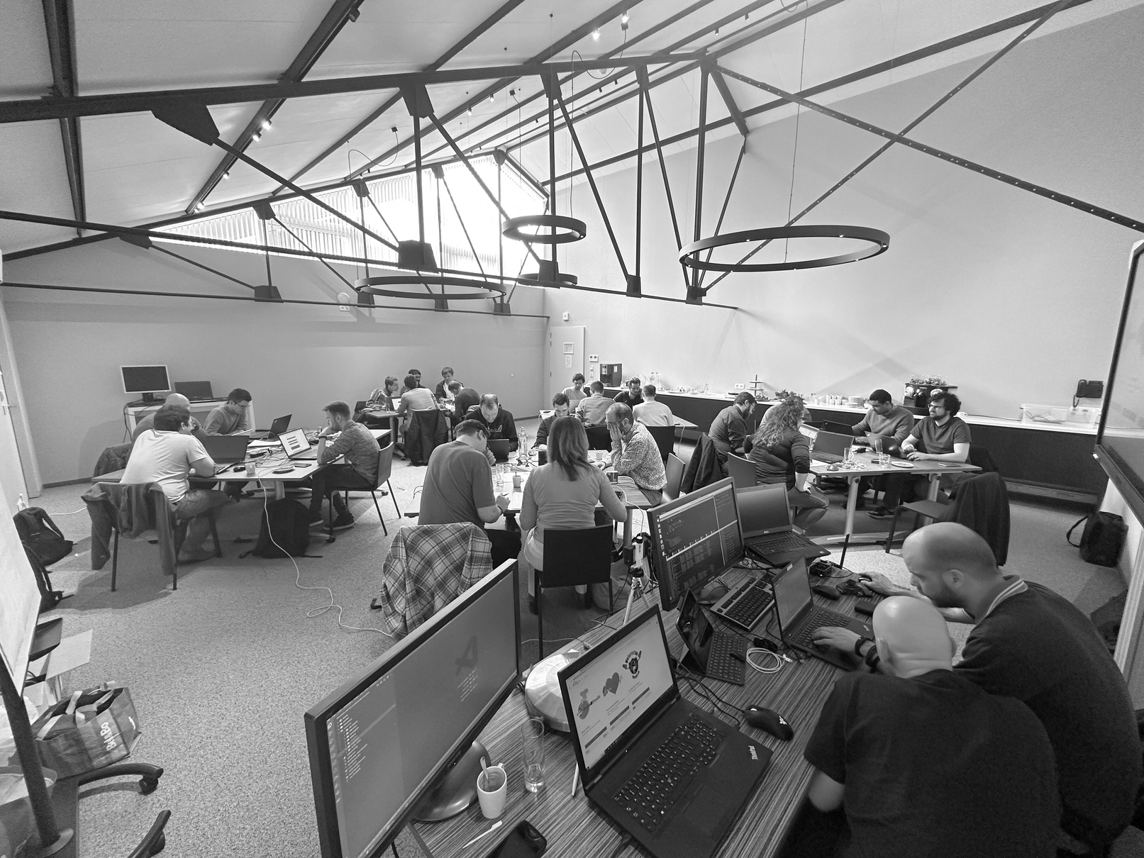

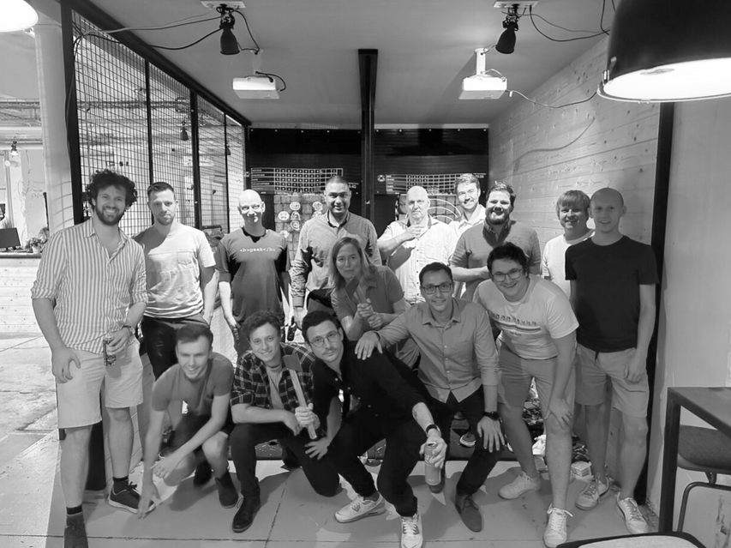


e2e testing with Playwright
WOUTER VAN SCHANDEVIJL

Slide 2

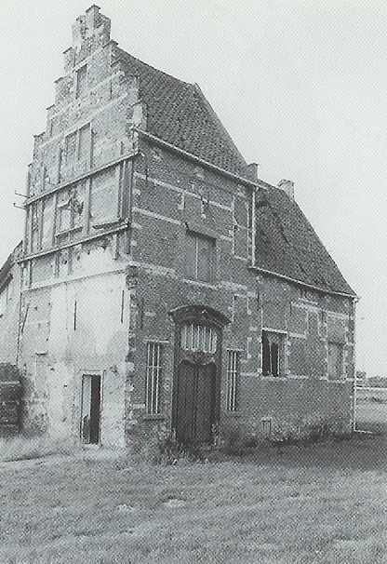





60min
Playwright
“someone who writes plays”
FrontendTrack
Hands-On
Introduction
QA Event

Slide 3


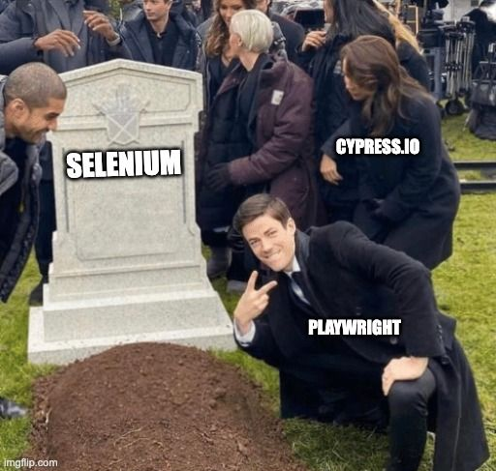


Slide 4



Menu
Playwright?
Demos
Exercises

Slide 5

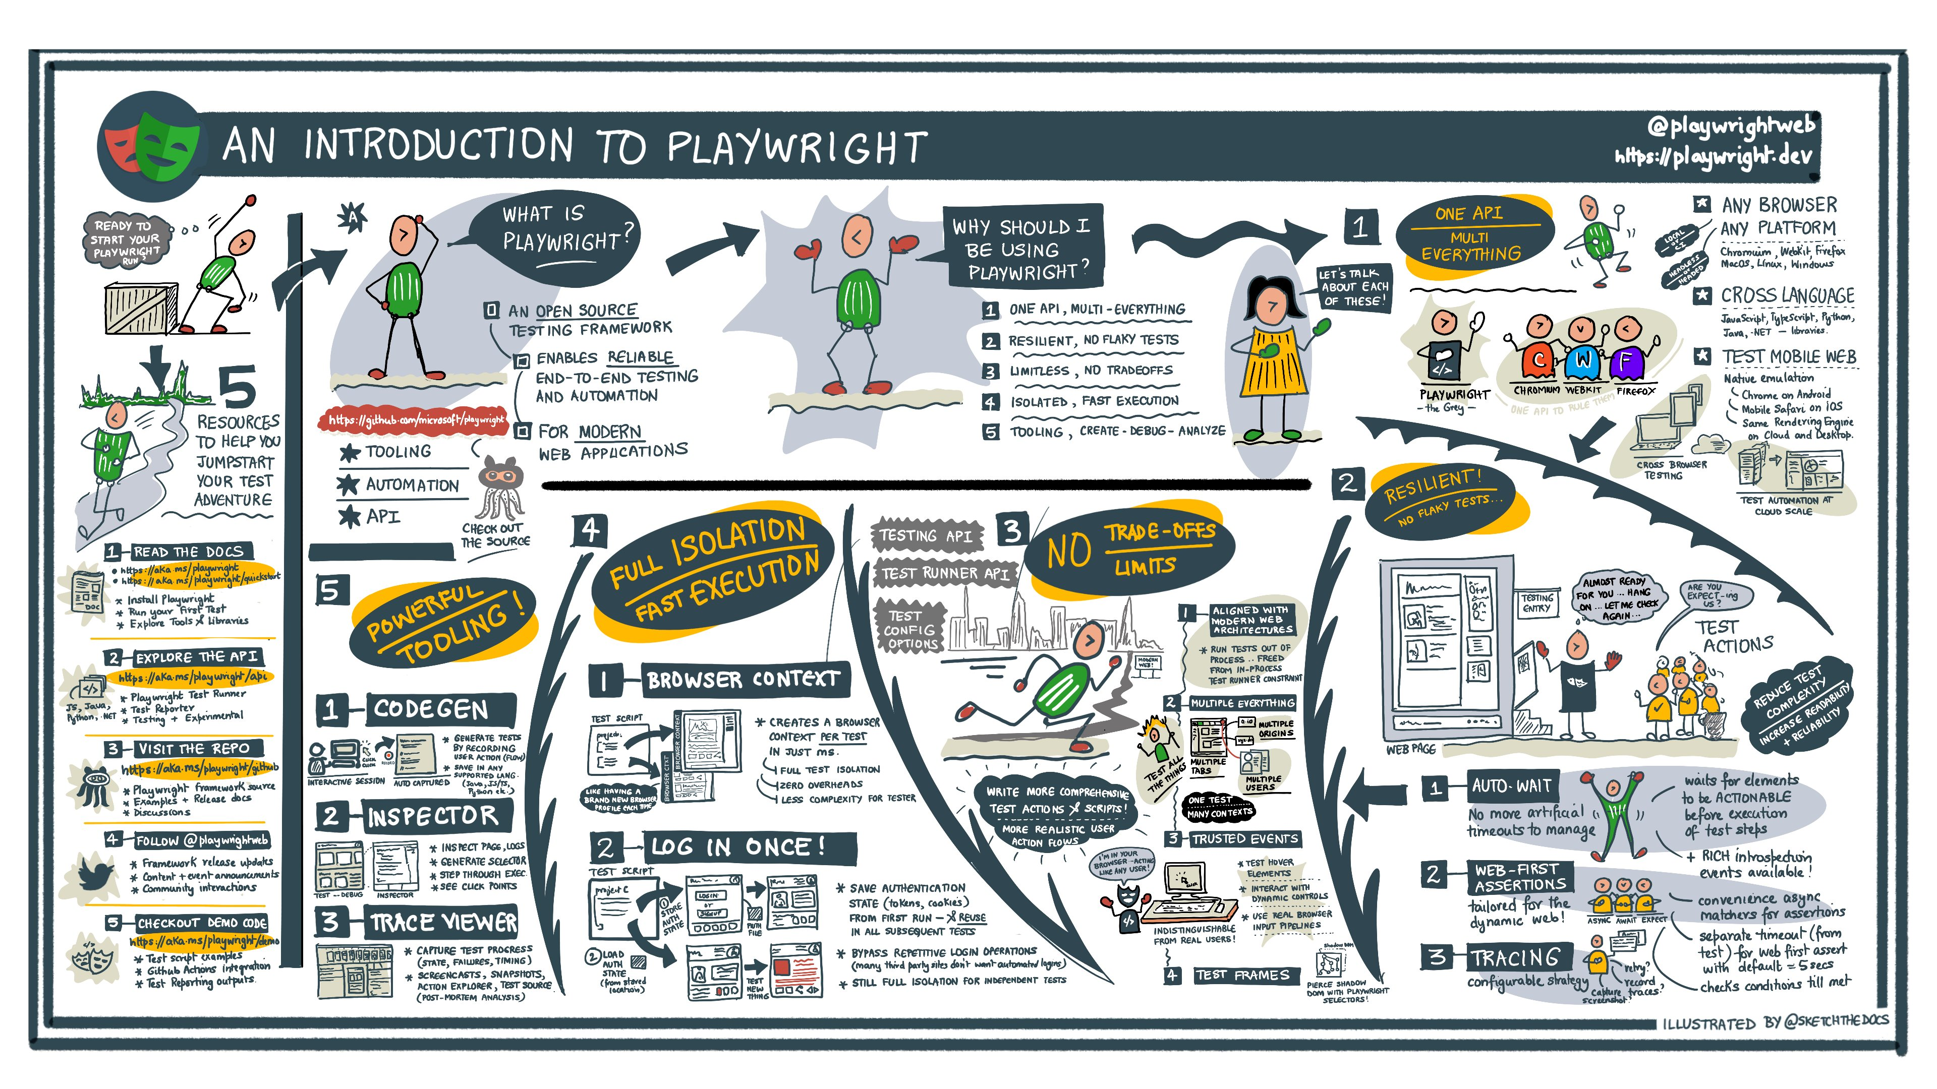

Slide 6

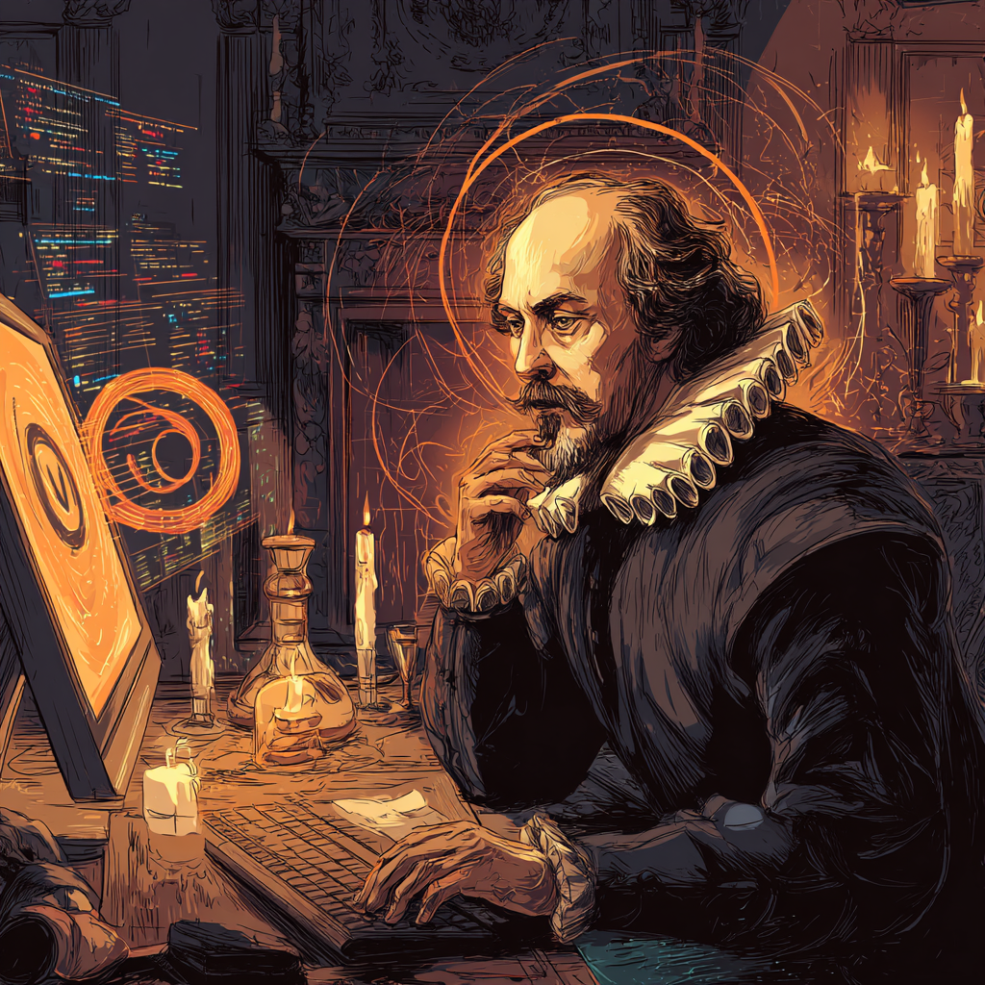

Playwright?
For Chromium, Firefox, WebKit and Mobile
In TypeScript, Python, .NET or Java
Playwright Test: the test runner
Headless/headed, CI, UI
Auto-wait: no timeouts required
Tracing: eliminate flakes with retries, videos, screenshots
Multiple tabs, users, browsers
Tooling: codegen, inspector, trace viewer
Sharding: run test suite on multiple machines
Experimental: component testing

Slide 8
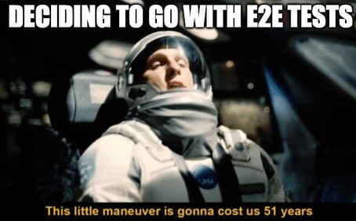

Slide 9








Our Socials
@itenium
@itenium_be
itenium
itenium-be
itenium.be
@itenium
itenium.be

Slide 10




WiFi: ITENIUM_GAST / FreeWifi

Slide 11



THANK YOU!

